Slide 1
Fixed Point Oblivious Amplitude Amplification with QSVT
Sharan Krishnan

Slide 2
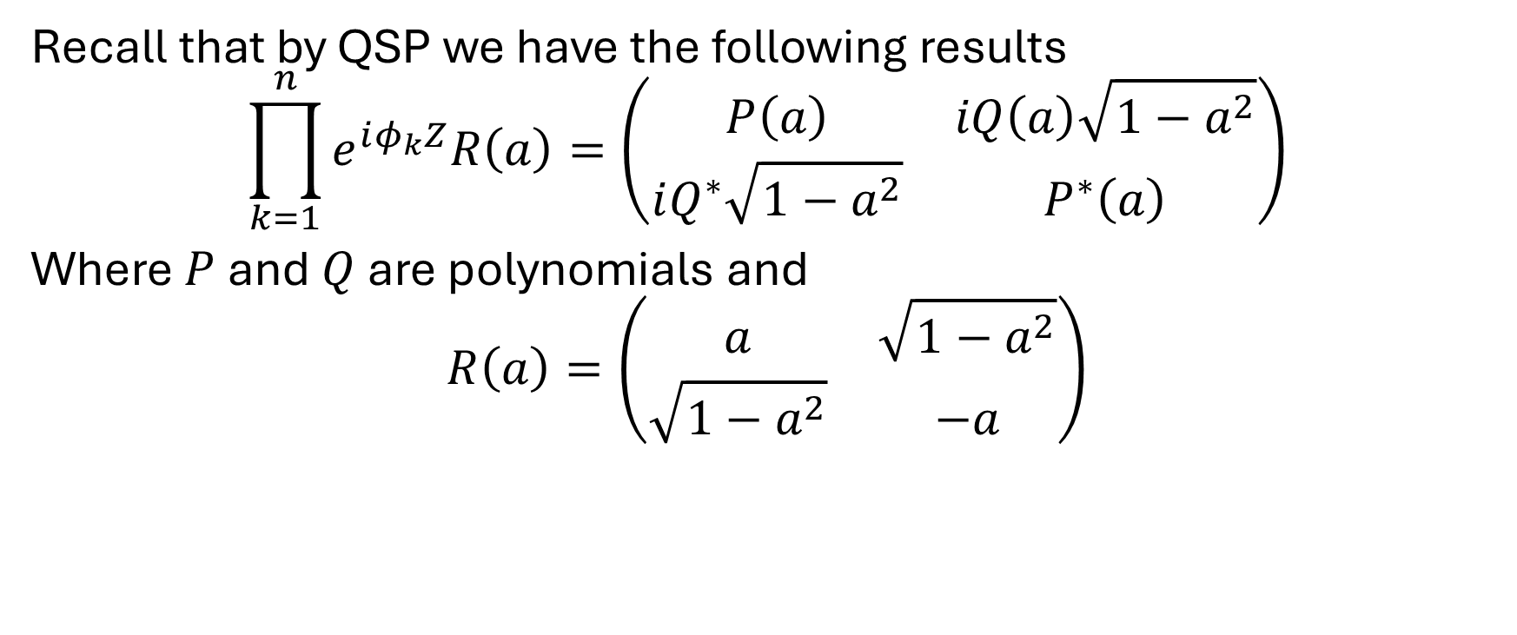
QSVT Recap
Recall that by QSP we have the following results
$$\prod_{k=1}^{n}{e^{iφ_{k}Z}R\left(a\right)}=\left(\begin{matrix}P\left(a\right) & iQ\left(a\right)\sqrt{1−a^{2}} \\ iQ^{∗}\sqrt{1−a^{2}} & P^{∗}\left(a\right)\end{matrix}\right)$$
Where $P$ and $Q$ are polynomials and
$$R\left(a\right)=\left(\begin{matrix}a & \sqrt{1−a^{2}} \\ \sqrt{1−a^{2}} & −a\end{matrix}\right)$$

Slide 3
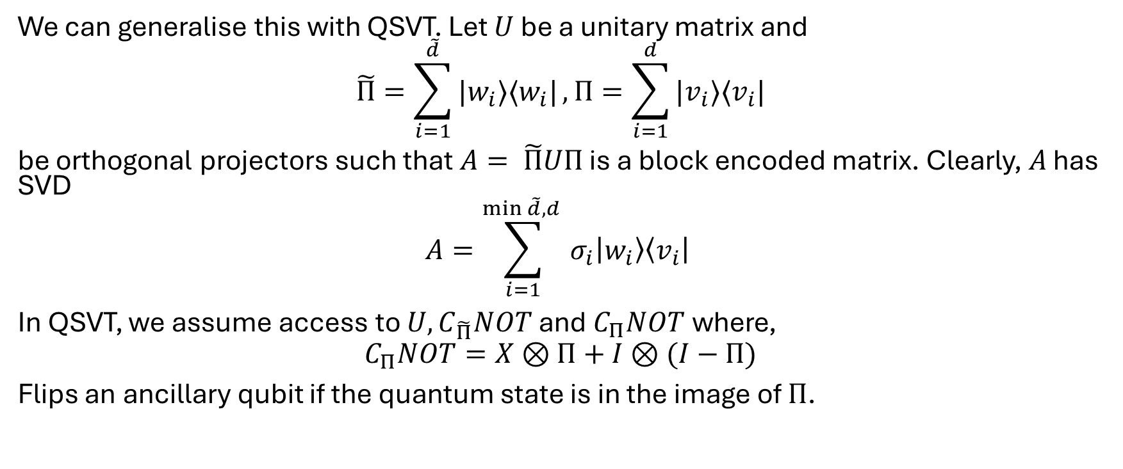
QSVT Recap
We can generalise this with QSVT. Let $U$ be a unitary matrix and
$$\tilde{Π}=\sum_{i=1}^{\tilde{d}}{|w_{i}⟩⟨w_{i}|}, Π=\sum_{i=1}^{d}{|v_{i}⟩⟨v_{i}|}$$
be orthogonal projectors such that $A= \tilde{Π}UΠ$ is a block encoded matrix. Clearly, $A$ has SVD
$$A=\sum_{i=1}^{\min{\tilde{d},d} }{σ_{i}\left|w_{i}\right\rangle \left\langle v_{i}\right|}$$ In QSVT, we assume access to $U, C_{\tilde{Π}}NOT$ and $C_{Π}NOT$ where,
$$C_{Π}NOT=X⊗Π+I⊗(I−Π)$$
Flips an ancillary qubit if the quantum state is in the image of $Π$.

Slide 4
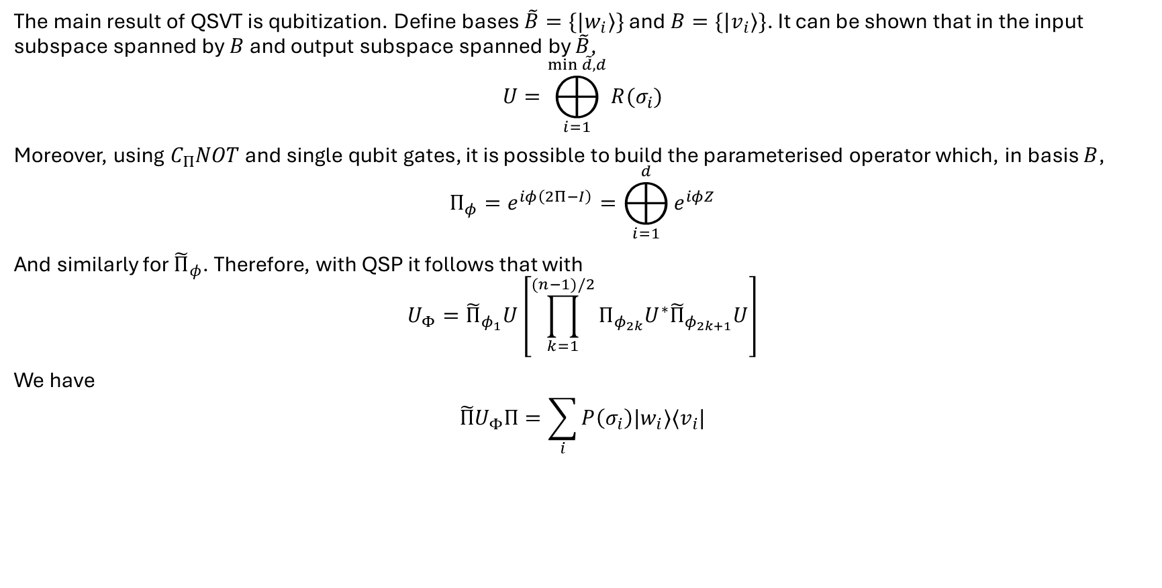
QSVT Recap
The main result of QSVT is qubitization. Define bases $\tilde{B}=\{|w_{i}⟩\}$ and $B=\{|v_{i}⟩\}$. It can be shown that in the input subspace spanned by $B$ and output subspace spanned by $\tilde{B}$,
$$U=⨁_{i=1}^{\min{\tilde{d},d}}{R(σ_{i})}$$
Moreover, using $C_{Π}NOT$ and single qubit gates, it is possible to build the parameterised operator which, in basis $B$,
$$Π_{φ}=e^{iφ\left(2Π−I\right)}=⨁_{i=1}^{d}{e^{iφZ}}$$
And similarly for ${\tilde{Π}}_{φ}$. Therefore, with QSP it follows that with
$$U_{Φ}={\tilde{Π}}_{φ_{1}}U\left[\prod_{k=1}^{(n−1)/2}{Π_{φ_{2k}}U^{∗}{\tilde{Π}}_{φ_{2k+1}}U}\right]$$
We have
$$\tilde{Π}U_{Φ}Π=\sum_{i}{P\left(σ_{i}\right)|w_{i}⟩⟨v_{i}|}$$

Slide 5
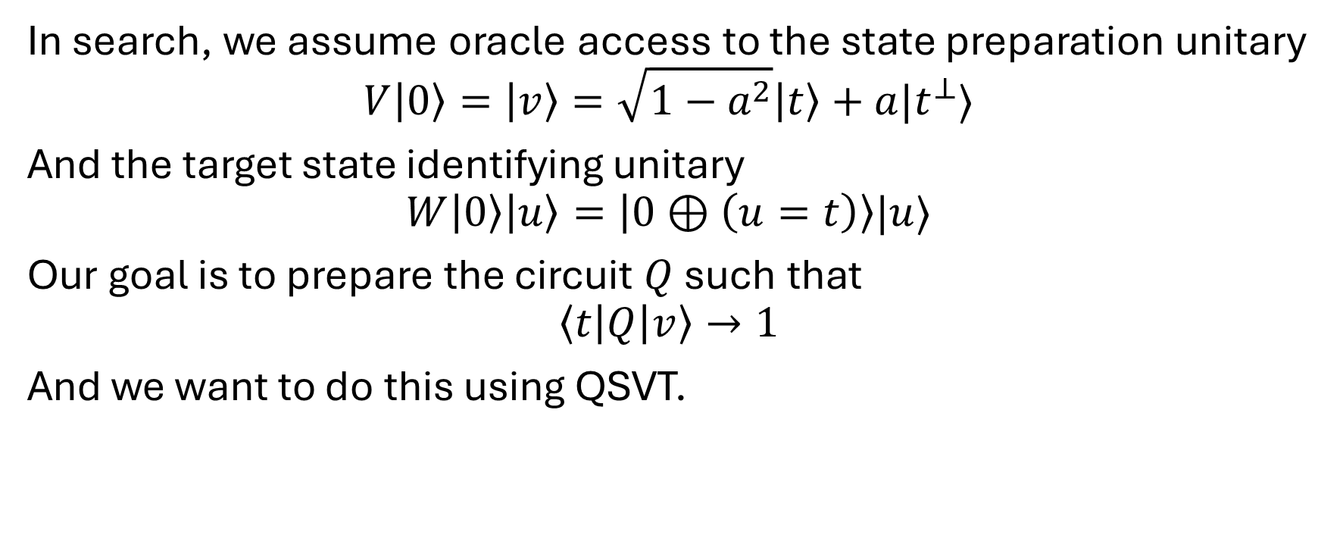
A simple application to search
In search, we assume oracle access to the state preparation unitary
$$V\left|0\right\rangle =\left|v\right\rangle =\sqrt{1−a^{2}}\left|t\right\rangle +a|t^{⊥}⟩$$
And the target state identifying unitary
$$W\left|0\right\rangle \left|u\right\rangle =\left|0⊕\left(u=t\right)\right\rangle |u⟩$$
Our goal is to prepare the circuit $Q$ such that
$$\left\langle t\left|Q\right|v\right\rangle →1$$
And we want to do this using QSVT.

Slide 6
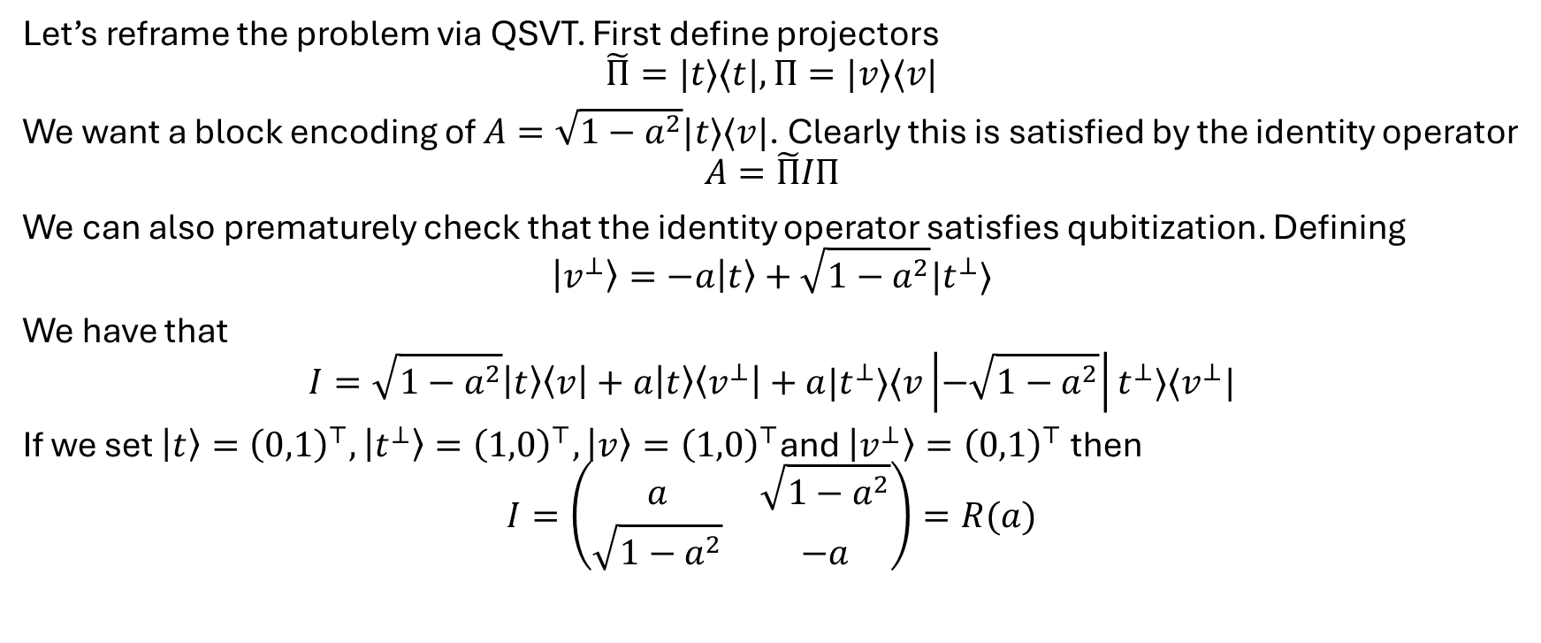
A simple application to search
Let’s reframe the problem via QSVT. First define projectors
$$\tilde{Π}=|t⟩⟨t|, Π=|v⟩⟨v|$$
We want a block encoding of $A=\sqrt{1−a^{2}}|t⟩⟨v|$. Clearly this is satisfied by the identity operator
$$A=\tilde{Π}IΠ$$
We can also prematurely check that the identity operator satisfies qubitization. Defining
$$\left|v^{⊥}\right\rangle =−a\left|t\right\rangle +\sqrt{1−a^{2}}|t^{⊥}⟩$$
We have that
$$I=\sqrt{1−a^{2}}\left|t\right\rangle \left\langle v\right|+a\left|t\right\rangle \left\langle v^{⊥}\right|+a|t^{⊥}⟩⟨v\left|−\sqrt{1−a^{2}}\right|t^{⊥}⟩⟨v^{⊥}|$$
If we set $\left|t\right\rangle ={\left(0,1\right)}^{⊤}, \left|t^{⊥}\right\rangle ={\left(1,0\right)}^{⊤},\left|v\right\rangle ={\left(1,0\right)}^{⊤}$and $\left|v^{⊥}\right\rangle ={\left(0,1\right)}^{⊤}$ then
$$I=\left(\begin{matrix}a & \sqrt{1−a^{2}} \\ \sqrt{1−a^{2}} & −a\end{matrix}\right)=R(a)$$

Slide 7
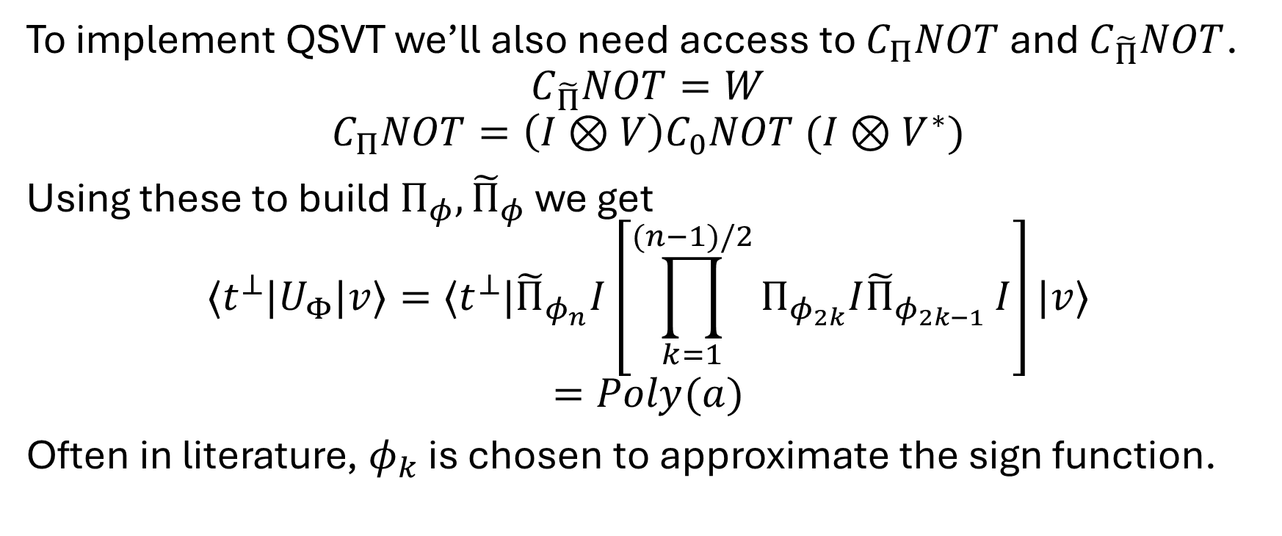
A simple application to search
To implement QSVT we’ll also need access to $C_{Π}NOT$ and $C_{\tilde{Π}}NOT$.
$$C_{\tilde{Π}}NOT=W$$
$$C_{Π}NOT=\left(I⊗V\right)C_{0}NOT (I⊗V^{∗})$$
Using these to build $Π_{φ},{\tilde{Π}}_{φ}$ we get
$${⟨t^{⊥}|U}_{Φ}|v⟩=⟨t^{⊥}|{\tilde{Π}}_{φ_{n}}I\left[\prod_{k=1}^{(n−1)/2}{Π_{φ_{2k}}I{\tilde{Π}}_{φ_{2k−1}}}I\right]|v⟩$$
$$=Poly(a)$$
Often in literature, $φ_{k}$ is chosen to approximate the sign function.

Slide 8
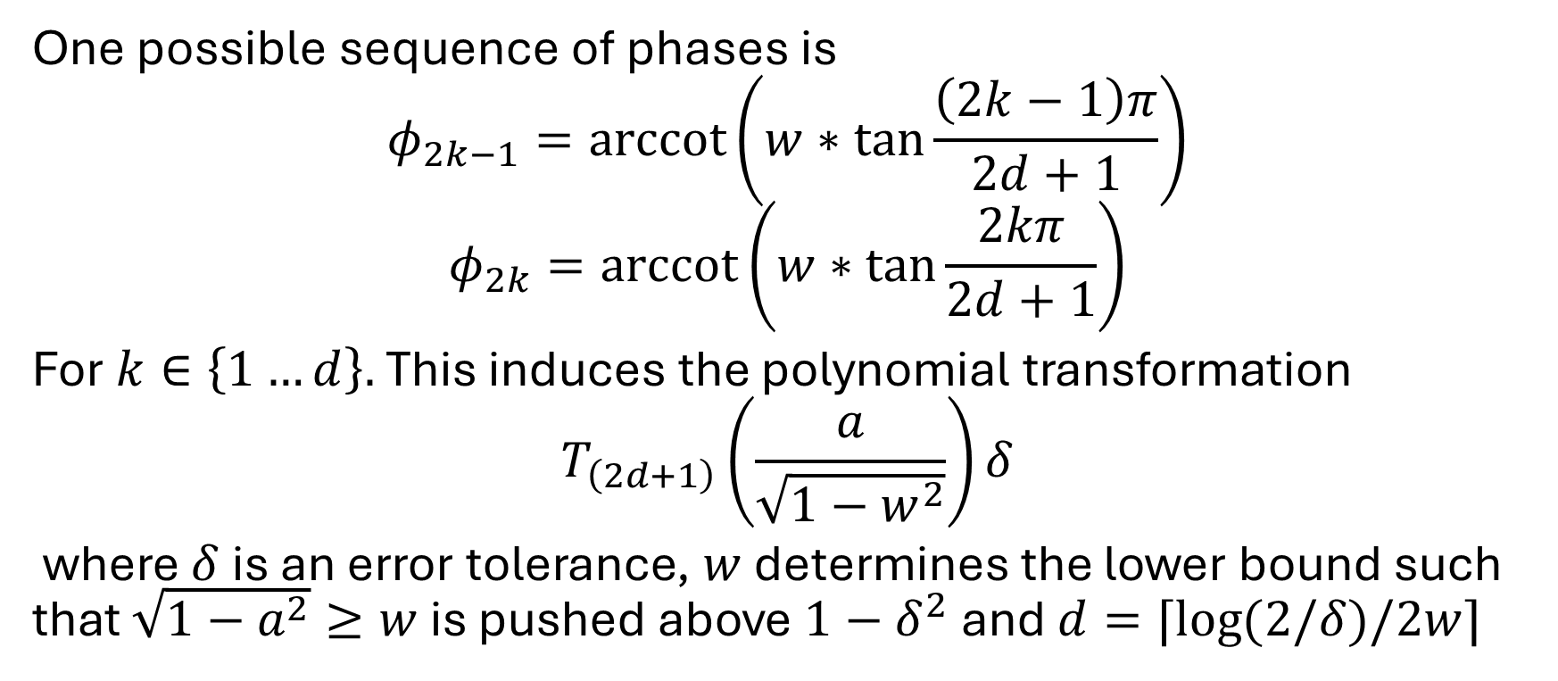
An alternative to sign
One possible sequence of phases is
$$φ_{2k−1}=\operatorname{arccot}\left(w∗\tan{\frac{\left(2k−1\right)π}{2d+1}}\right)$$
$$φ_{2k}=\operatorname{arccot}\left(w∗\tan{\frac{2kπ}{2d+1}}\right)$$
For $k∈\left\{1…d\right\}.$ This induces the polynomial transformation
$$T_{\left(2d+1\right)}\left(\frac{a}{\sqrt{1−w^{2}}}\right)δ$$
where $δ$is an error tolerance, $w$ determines the lower bound such that $\sqrt{1−a^{2}}≥w$ is pushed above $1−δ^{2}$ and $d=⌈\log{(2/δ)/2w⌉}$

Slide 9
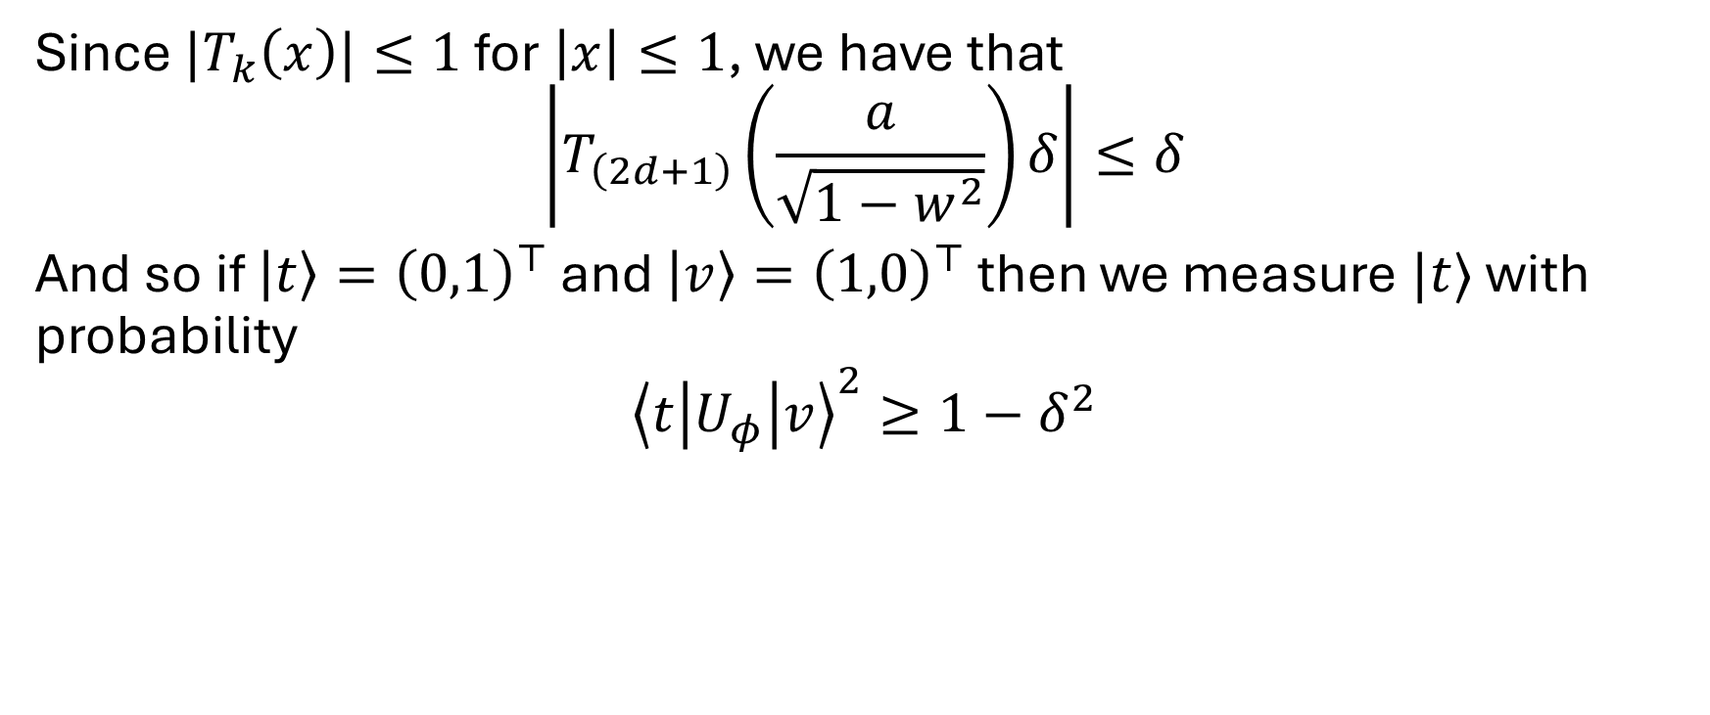
An alternative to sign
Since $|T_{k}\left(x\right)|≤1$ for $\left|x\right|≤1$, we have that
$$\left|T_{\left(2d+1\right)}\left(\frac{a}{\sqrt{1−w^{2}}}\right)δ\right|≤δ$$
And so if $\left|t\right\rangle ={\left(0,1\right)}^{⊤}$ and $\left|v\right\rangle ={\left(1,0\right)}^{⊤}$ then we measure $|t⟩$ with probability
$${\left\langle t\left|U_{φ}\right|v\right\rangle }^{2}≥1−δ^{2}$$

Slide 10
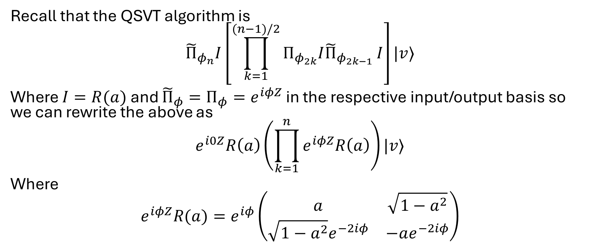
Proof sketch
Recall that the QSVT algorithm is
$${\tilde{Π}}_{φ_{n}}I\left[\prod_{k=1}^{(n−1)/2}{Π_{φ_{2k}}I{\tilde{Π}}_{φ_{2k−1}}}I\right]|v⟩$$
Where $I=R(a)$ and ${\tilde{Π}}_{φ}=Π_{φ}=e^{iφZ}$ in the respective input/output basis so we can rewrite the above as
$$e^{i0Z}R\left(a\right)\left(\prod_{k=1}^{n}{e^{iφZ}R\left(a\right)}\right)|v⟩$$
Where
$$e^{iφZ}R(a)=e^{iφ}\left(\begin{matrix}a & \sqrt{1−a^{2}} \\ \sqrt{1−a^{2}}e^{−2iφ} & −ae^{−2iφ}\end{matrix}\right)$$

Slide 11
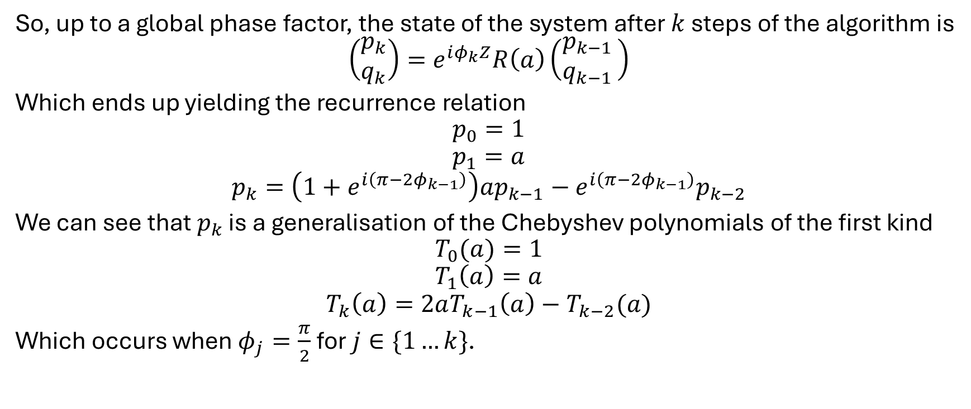
Proof sketch
So, up to a global phase factor, the state of the system after $k$ steps of the algorithm is
$$\left(\begin{matrix}p_{k} \\ q_{k}\end{matrix}\right)=e^{iφ_{k}Z}R\left(a\right)\left(\begin{matrix}p_{k−1 } \\ q_{k−1 }\end{matrix}\right)$$
Which ends up yielding the recurrence relation
$$p_{0}=1$$
$$p_{1}=a$$
$$p_{k}=\left(1+e^{i\left(π−2φ_{k−1}\right)}\right)ap_{k−1}−e^{i\left(π−2φ_{k−1}\right)}p_{k−2}$$
We can see that $p_{k}$ is a generalisation of the Chebyshev polynomials of the first kind
$$T_{0}(a)=1$$
$$T_{1}\left(a\right)=a$$
$$T_{k}\left(a\right)=2aT_{k−1}\left(a\right)−T_{k−2}(a)$$
Which occurs when $φ_{j}=\frac{π}{2}$ for $j∈\{1…k\}$.

Slide 12
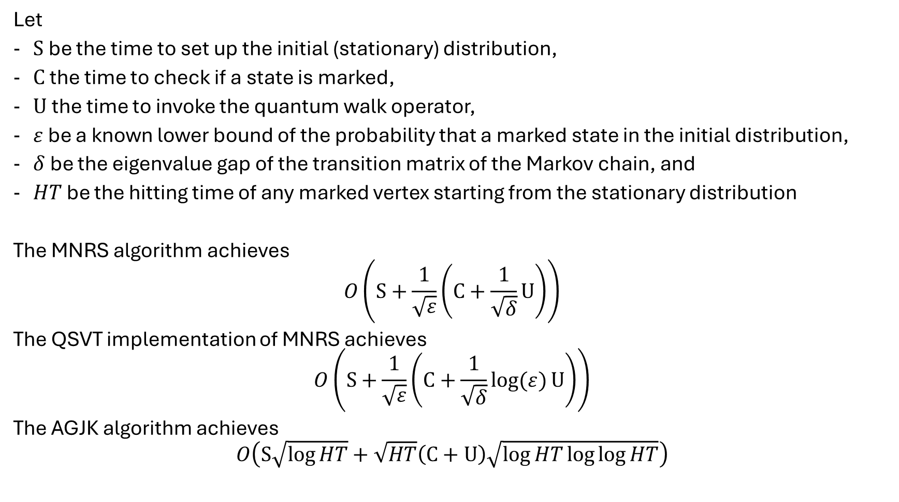
Let
$S$ be the time to set up the initial (stationary) distribution,
$C$ the time to check if a state is marked,
$U$ the time to invoke the quantum walk operator,
$ε$ be a known lower bound of the probability that a marked state in the initial distribution,
$δ$ be the eigenvalue gap of the transition matrix of the Markov chain, and
$HT$ be the hitting time of any marked vertex starting from the stationary distribution
The MNRS algorithm achieves
$$O\left(S+\frac{1}{\sqrt{ε}}\left(C+\frac{1}{\sqrt{δ}}U\right)\right)$$
The QSVT implementation of MNRS achieves
$$O\left(S+\frac{1}{\sqrt{ε}}\left(C+\frac{1}{\sqrt{δ}}\log{(ε)}U\right)\right)$$
The AGJK algorithm achieves
$$O\left(S\sqrt{\log{HT}}+\sqrt{HT}\left(C+U\right)\sqrt{\log{HT}\log{\log{HT}}}\right)$$

